Slide 1
Context Switching

Slide 2
Context switch is the process of storing the state of a process or of a thread, so that it can be restored and execution resumed from the same point later. This allows multiple processes to share a single CPU, and is an essential feature of a multitasking operating system.

Slide 3
A register holds the current CPU instruction.
A program counter, also known as an instruction address register, is a small amount of fast memory that holds the address of the instruction to be executed immediately after the current one.

Slide 4
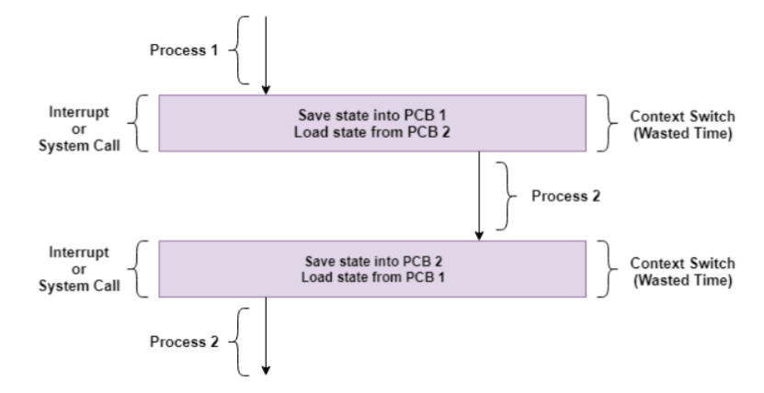
initially Process 1 is running.Process 1 is
switched out and Process 2 is switched in
because of an interrupt or a system call.
Context switching involves saving the state
of Process 1 into PCB1 and loading the state
of process 2 from PCB2. After some time
again a context switch occurs and Process 2
is switched out and Process 1 is switched in
again. This involves saving the state of
Process 2 into PCB2 and loading the state of
process 1 from PCB1.

Slide 5
Context Switching Triggers
Multitasking: In a multitasking environment, a process is switched out of the CPU so another process can be run. The state of the old process is saved and the state of the new process is loaded.
Interrupt Handling: The hardware switches a part of the context when an interrupt occurs. This happens automatically. Only some of the context is changed to minimize the time required to handle the interrupt.
User and Kernel Mode Switching: A context switch may take place when a transition between the user mode and kernel mode is required in the operating system.

Slide 6
Context Switching Steps
Save the context of the process that is currently running on the CPU. Update the process control block and other important fields.
Move the process control block of the above process into the relevant queue such as the ready queue, I/O queue etc.
Select a new process for execution.
Update the process control block of the selected process. This includes updating the process state to running.
Update the memory management data structures as required.
Restore the context of the process that was previously running when it is loaded again on the processor. This is done by loading the previous values of the process control block and registers.

Slide 7
Context Switching Cost
Context Switching leads to an overhead cost because of TLB(translation lookaside buffer), sharing the cache between multiple tasks, running the task scheduler etc. Context switching between two threads of the same process is faster than between two different processes as threads have the same virtual memory maps.

